Slide 1

Project Presentation of Industry Oriented Hands on Experience (22CS422)
On
SmartLearn (An AI-Based Academic Support Platform)
Presented By:
1. Rahul Kumar (2211981286)
2. Rahul Kumar (2211981287)
3. Rahul Patra (2211981290)
4. Rahul Samanta (2211981291)
Supervised By:
Dr. Preeti Saini (CET1000874)
Assistant Professor
Chitkara University, Rajpura
Department of Computer Science and Engineering,
Chitkara University, Punjab
1

Slide 2
Introduction
SmartLearn is an AI-Based Academic Support Platform for learning from PDF documents.
Students mainly study from PDF notes and digital materials.
Reading long documents takes a lot of time.
Difficult to quickly find important concepts and topics.
Students use multiple tools for summaries, quizzes, and notes.
This makes learning slow and unorganized.
SmartLearn provides summary, flashcards, quizzes, and AI chat in one place.
2

Slide 3
Technology Stack
Frontend: React.js (for building user interface)
Backend: Node.js and Express.js (for server and APIs)
Database: MongoDB (for storing user and project data)
Authentication: JWT (JSON Web Token for secure login)
AI Integration: Google Gemini API (for chat, summary, quiz, flashcards)
UI Design: Tailwind CSS (for responsive and modern design)
Development Tool: Visual Studio Code
3

Slide 4
Project Abstract
SmartLearn is an AI-Based Academic Support Platform where students can learn efficiently from PDF documents in one place.
Upload PDF notes, slides, and study materials
Read documents using built-in PDF viewer
Ask questions and get answers using AI
Generate quick summaries automatically
Create flashcards for easy revision
Generate quizzes for practice
This makes studying faster, more organized, and interactive, helping students improve understanding and prepare better for exams.
4

Slide 5
Objectives
To develop an AI-Based Academic Support Platform that helps students learn from PDF documents efficiently.
To provide automatic document summarization for quick understanding of lengthy study materials.
To enable AI-based question answering for better concept clarity from uploaded documents.
To generate flashcards automatically for effective and quick revision.
To create multiple-choice quizzes for self-assessment and exam preparation.
To integrate all study tools into a single platform for better organization.
To track user learning progress using a dashboard with activity details.
5

Slide 6
Key Features
User Authentication: Secure login and signup using JWT
PDF Upload & Management: Upload and manage study documents easily
Embedded PDF Viewer: Read documents directly within the platform
AI Chat Support: Ask questions and get answers from documents using AI
Document Summarization: Generate concise summaries automatically
Flashcard Generation: Create flashcards for quick revision
Quiz Generator: Generate MCQ quizzes for practice
Quiz Analytics: View scores, correct answers, and explanations
Progress Dashboard: Track learning activity and progress
Responsive UI: Works smoothly on desktop and mobile devices
6

Slide 7
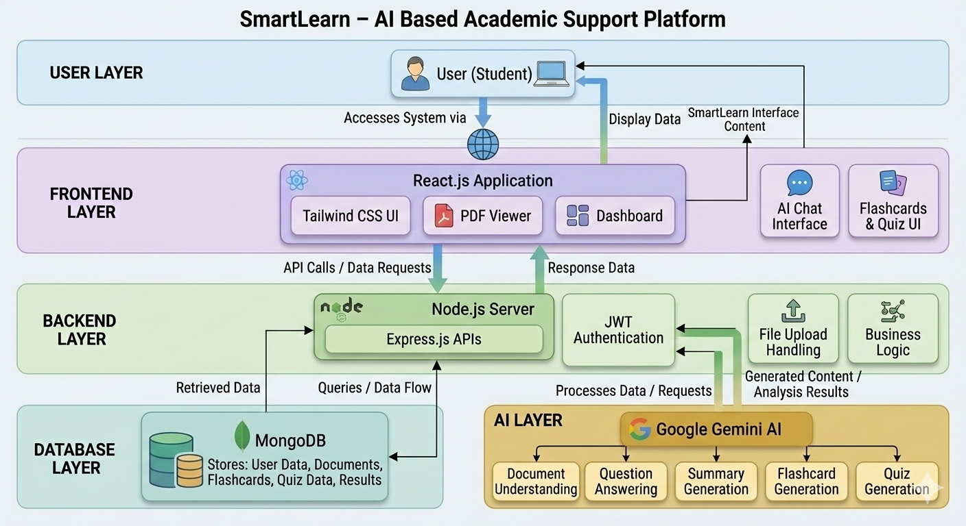
High-Level Design
7

Slide 8
System Architecture
The system follows a 3-tier architecture: Frontend, Backend, and Database
Frontend (React.js + Tailwind CSS) handles user interface and interactions
Users can upload PDFs, view documents, and access AI features through UI
Backend (Node.js + Express.js) processes requests and manages application logic
Implements JWT authentication for secure login and access control
AI Layer (Google Gemini) handles summary, chat, flashcards, and quiz generation
Database (MongoDB) stores users, documents, flashcards, quizzes, and results
Data flows from User → Frontend → Backend → AI/Database → Frontend
8

Slide 9
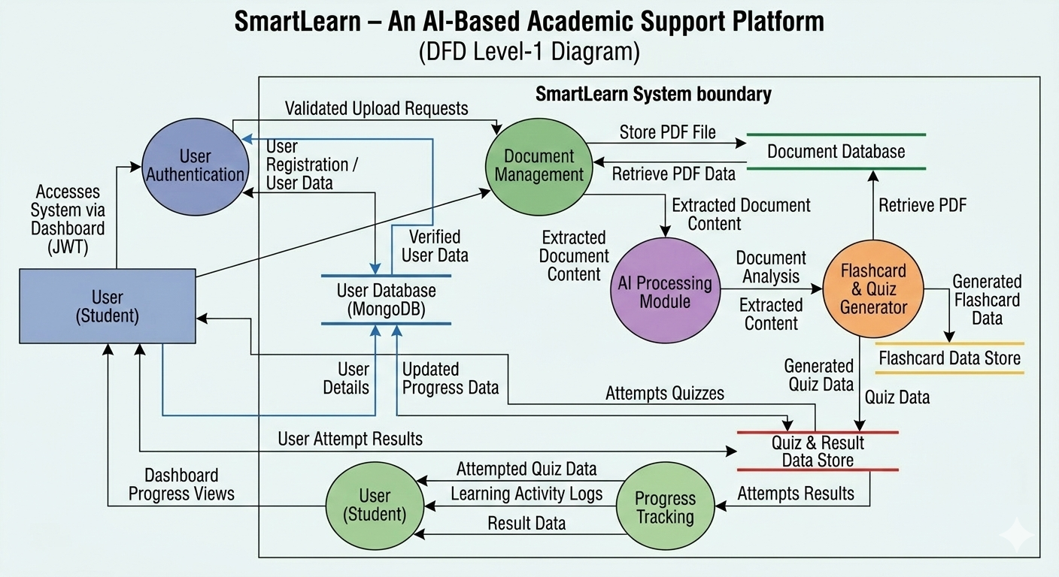
Data Flow Diagram
9

Slide 10
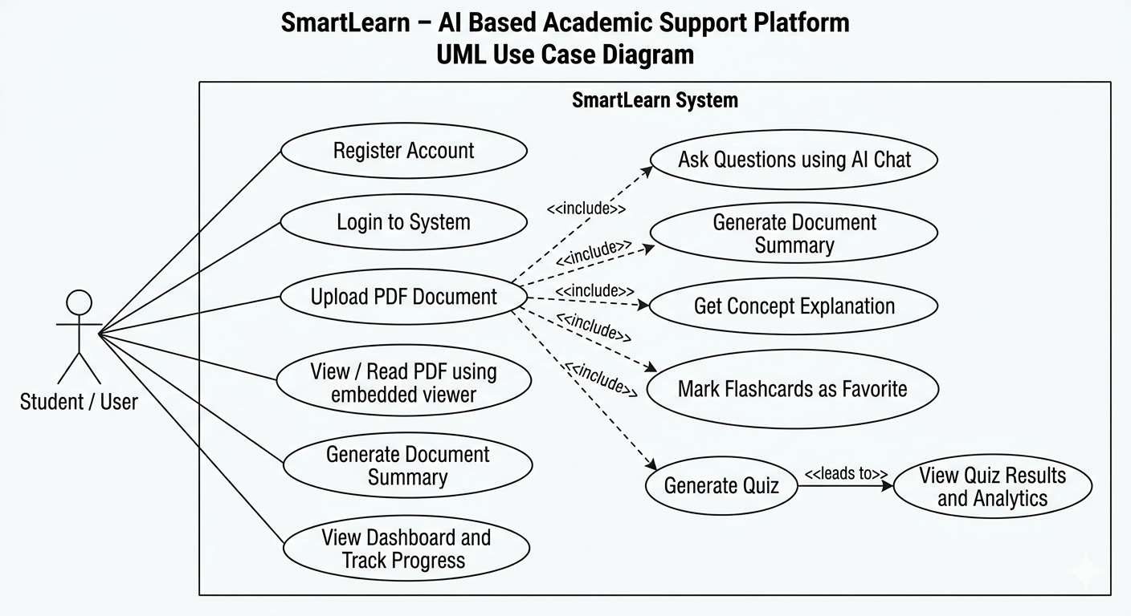
Use Case Diagram
Represents interaction between user and system.
Shows all functionalities available in SmartLearn.
User can upload, read, and interact with PDFs.
AI features include chat, summary, and explanation.
Supports flashcards and quiz generation.
Helps track learning progress via dashboard.
Provides a complete study solution in one platform
10

Slide 11
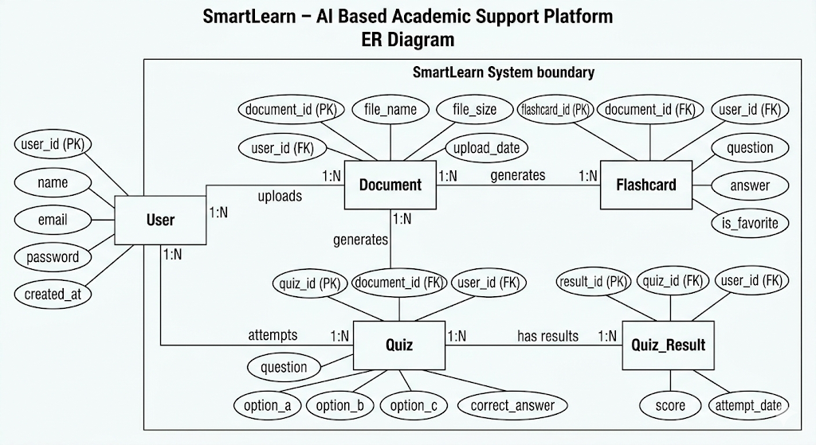
ER Diagram
11

Slide 12
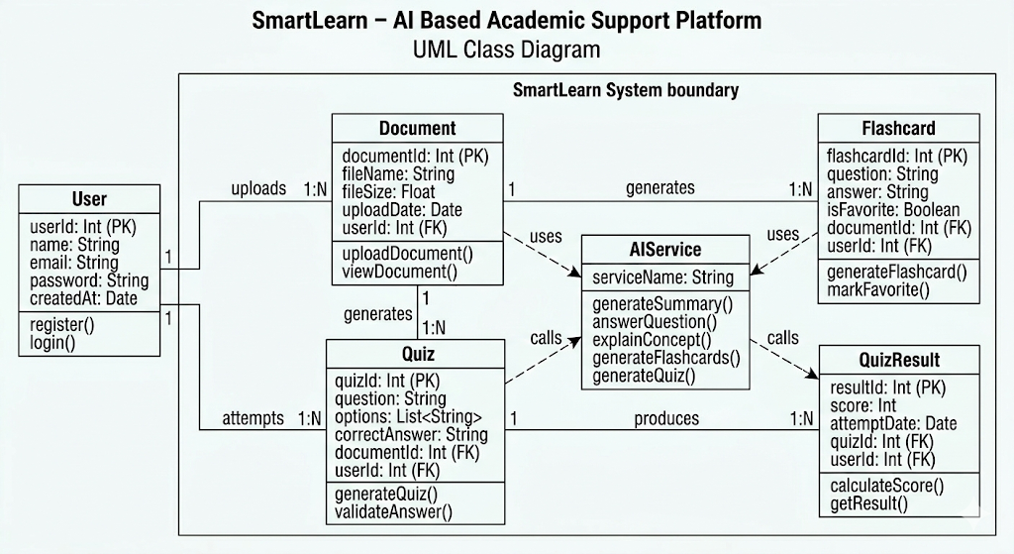
Class Diagram
12

Slide 13
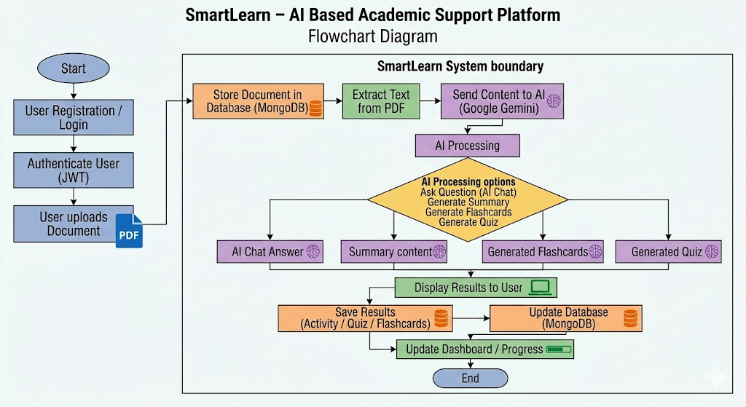
Flow Chart
13

Slide 14
Testing & Results
📌 Testing:
Performed Unit Testing for each module (authentication, upload, AI features).
Conducted Integration Testing to check frontend-backend communication.
Verified all features through Functional Testing.
Tested UI for responsiveness and smooth navigation.
Checked system performance with large PDF files.
📌 Results:
PDF upload and viewing worked successfully.
AI generated accurate summaries, answers, flashcards, and quizzes.
Quiz system displayed correct results with explanations.
Dashboard showed user progress and activity properly.
Overall system provided a smooth and user-friendly experience.
14

Slide 15
Limitations
AI responses may vary in accuracy depending on the quality and content of the uploaded PDF.
The system depends on internet connectivity for AI features like chat, summary, and quiz generation.
Currently supports only PDF format, not other file types like Word or PowerPoint.
Processing large documents may take more time and affect performance.
Limited support for offline usage, as most features require backend and AI access.
Quiz and flashcard generation may not always cover all important concepts perfectly.
The system currently supports basic user interaction and lacks advanced personalization features.
15

Slide 16
Future Scope
Implement offline mode for basic features without internet.
Improve AI accuracy with advanced models and better training.
Add support for multiple file formats such as Word, PPT, and images.
Add personalized learning recommendations based on user activity.
Develop a mobile application for better accessibility.
Integrate voice-based interaction (speech-to-text and text-to-speech).
Add collaborative learning features like group study and sharing.
Enhance dashboard with advanced analytics and performance insights.
16

Slide 17
Thank You
17

